Slide 1
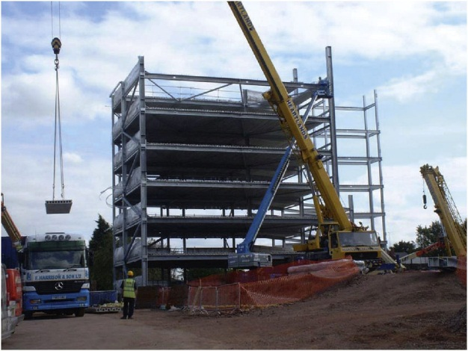
FIGURE 17.1 Lifting Precast Pretensioned Concrete Flooring Units onto a Steel Frame

Slide 2
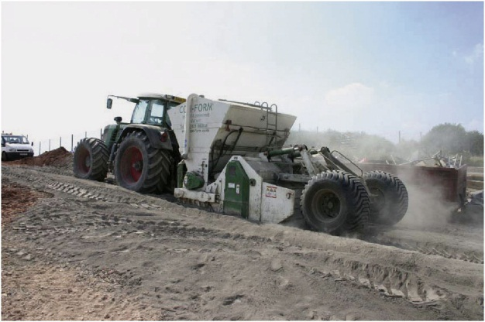
FIGURE 17.2 Soil Stabilisation

Slide 3
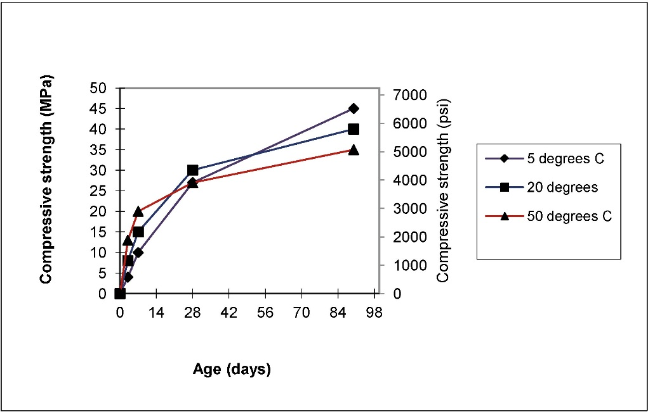
FIGURE 17.3 Typical Strength Gain Data at Different Temperatures

Slide 4
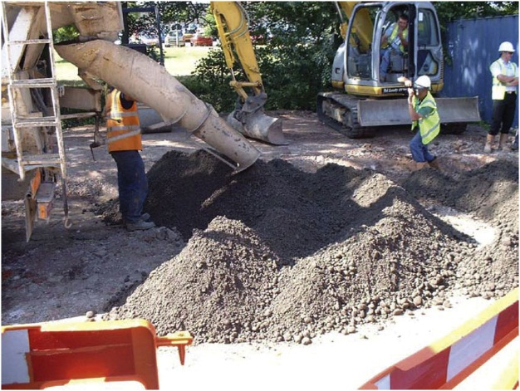
FIGURE 17.4 Semidry Concrete for a Road Foundation

Slide 5
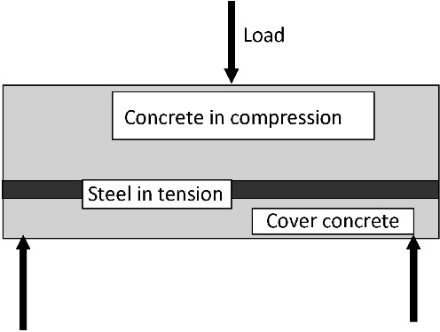
FIGURE 17.5 Schematic Diagram of Simply Reinforced Concrete Beam

